Slide 1
www.feedcraven.org

Slide 2
Feed Craven Food Pantry
Who we are
Where we are
Where we want to be

Slide 3
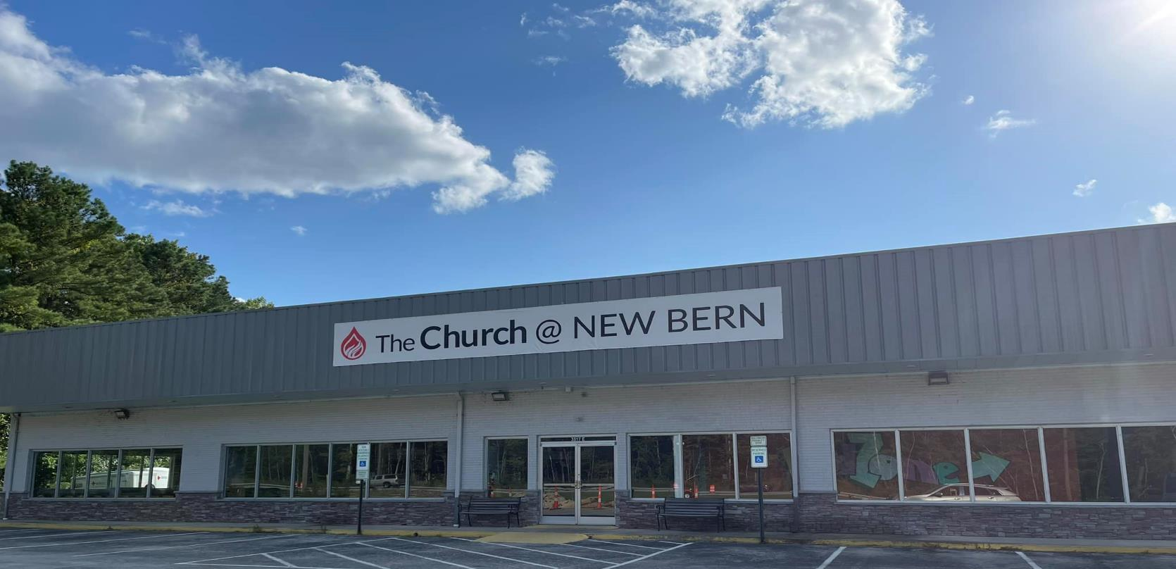
Who We Are…
We are a local food pantry that is a ministry branch of The Church at New Bern.

Slide 4

Who We Are…
The Church provides warehouse space; pays for the electricity to run the lights, refrigerators, and freezers; and use of the facility for food distribution nights.
The food pantry operates solely on the funds brought in from outside sources, not from the church. The food pantry does not provide funds for other church ministries.

Slide 5
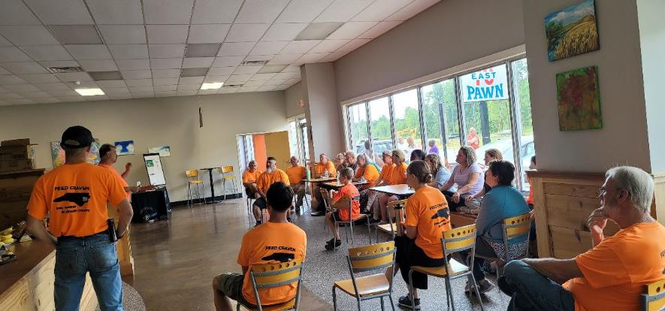
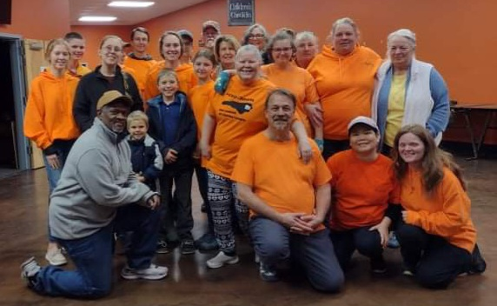
Who We Are…
We are a team of over 30 unpaid volunteers.
We range in age from 6 to late 70’s.
We have one to two fluent Spanish translators.
We serve people who mainly live in Craven.
We do support people which do live in surrounding counties as we are more convenient for them to visit.

Slide 6
We Are A Disaster Relief Agency
We are here to help whether the disaster is man made or natural.
We work in unison with Eastern NC Food Bank for food and water supplies.
We distributed ready to eat meals and water.
We work with local and national companies to provide cleaning supplies and personal protection equipment.
Potential for providing shelter for those in need.
Greatest potential period is mid August – mid October

Slide 7
Where We Are…
Our Guests
Food Sources
Food Bank Prices
Warehouse Supplies – We could use plastic grocery bags!
Volunteers
Guests Stories

Slide 8
Where We Are…
In July 2023, we supported:
  190 households which met low-income guidelines for North Carolina.
  324 households of all income brackets.
  555 people which met low-income guidelines for North Carolina.
  851 people of all income brackets.
We have seen the number of low-income households increase for the past 5 distributions. We expect it to continue increasing as we reach more people in the communities.

Slide 9
Our Guests’ Demographics
Currently we serve 25% children, 15% young adults, 35% middle-age adults, and 25% elderly.
20% Hispanic, 35% Caucasian, and 45% African Americans.
60% Female, 40% Male.
37% on food stamps, 63% not.
$1400 average monthly income.
Average household size is 3. Our largest household family member count is 11.

Slide 10
Who Can Qualify?
Everyone in need of nutritional healthy food.
There are governmental restriction on who can receive foods purchased by the USDA.
Everyone will receive food which is not purchased by the USDA.

Slide 11
Who Can Qualify for TEFAP?
Number of People in Household | Maximum Monthly Income | Maximum Annual Income
1 | $2,266 | $27,192
2 | $3,052 | $36,624
3 | $3,840 | $46,080
4 | $4,626 | $55,512
5 | $5,412 | $64,944
6 | $6,200 | $74,400
7 | $6,986 | $83,832
8 | $7,772 | $93,264
Each Additional Family Member | + $788 | + 9,456

Slide 12
Where We Are…
Food Sources Come From
The Emergency Food Assistance Program
Farm Donations
Commercial Donations
Private Donations

Slide 13
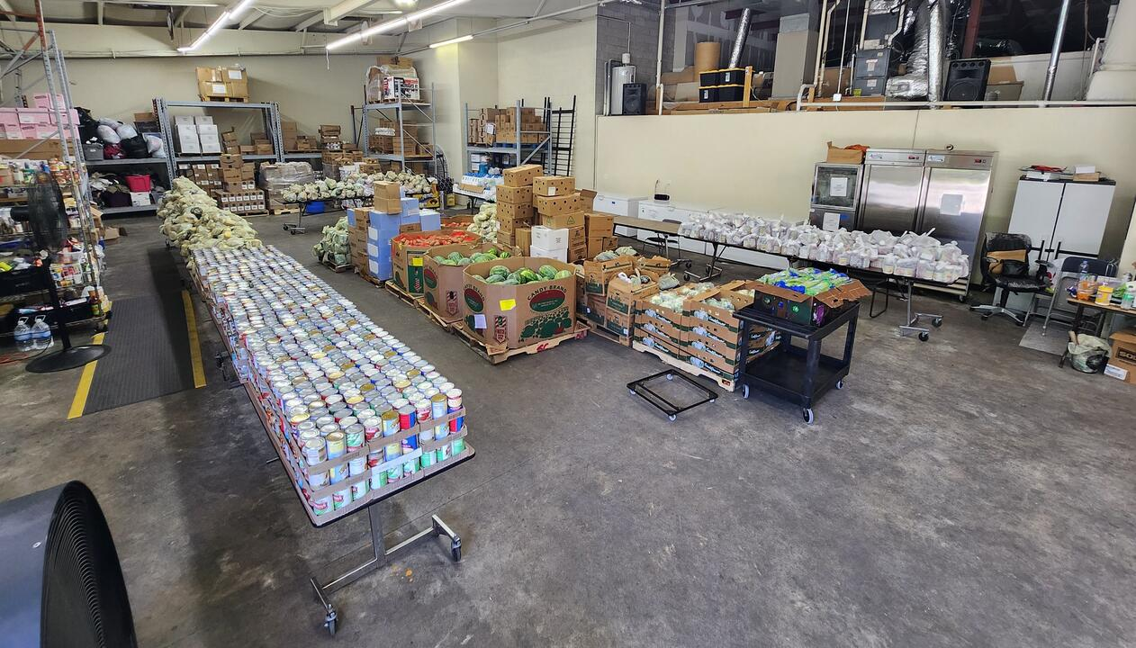

Slide 14
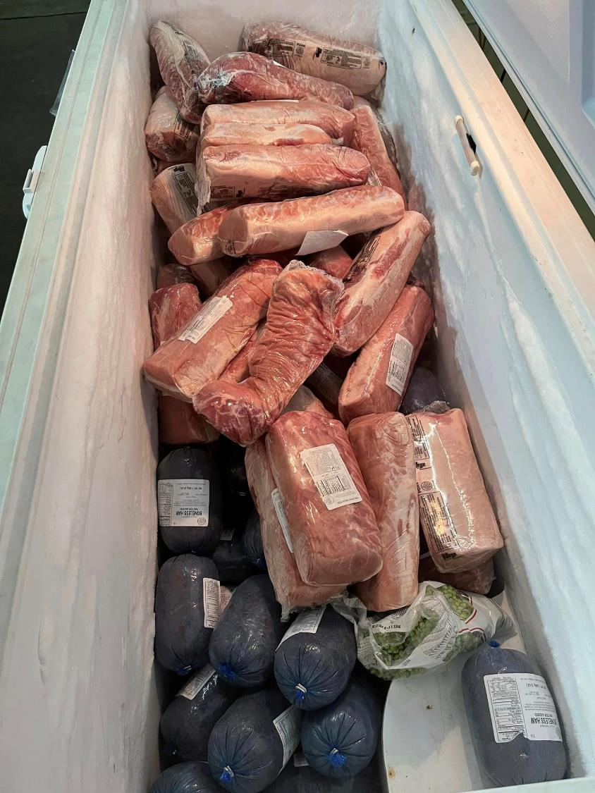
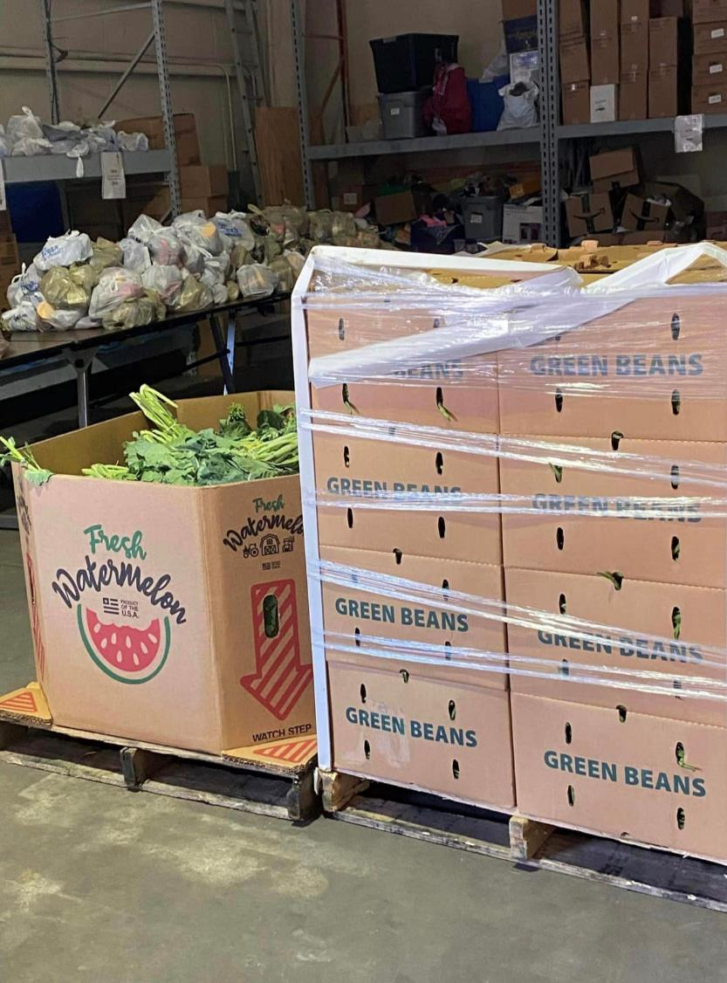
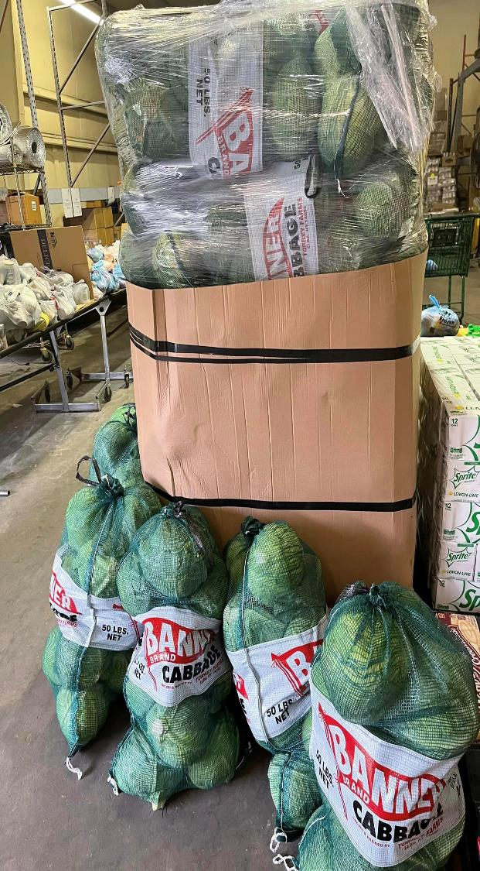

Slide 15
The Emergency Food Assistance Program
This is a USDA funded program.
Program is designed to supplement the food needs of low-income households.
TEFAP is not intended to be a household’s primary food source.
Individuals/Households currently receiving NC Food and Nutrition Services (FNS) are eligible for benefits.
Individuals/Households whose income is at or below the NC Department of Health & Human Services income poverty guidelines based upon household size and income.

Slide 16
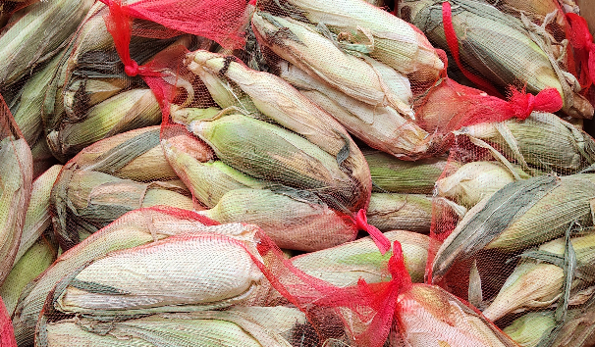

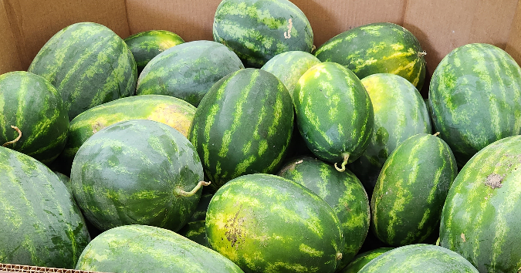
Farm Donations
Many farmers donate their excess crops through the food bank.
Farmers receive a tax break.

Slide 17
Other Foods
When insufficient grocery items are not provided through the main suppliers, we will purchase additional food when funds are available.
For the past couple years, we have seen an absence of milk, cheese, eggs, peanut butter, and various other proteins.

Slide 18
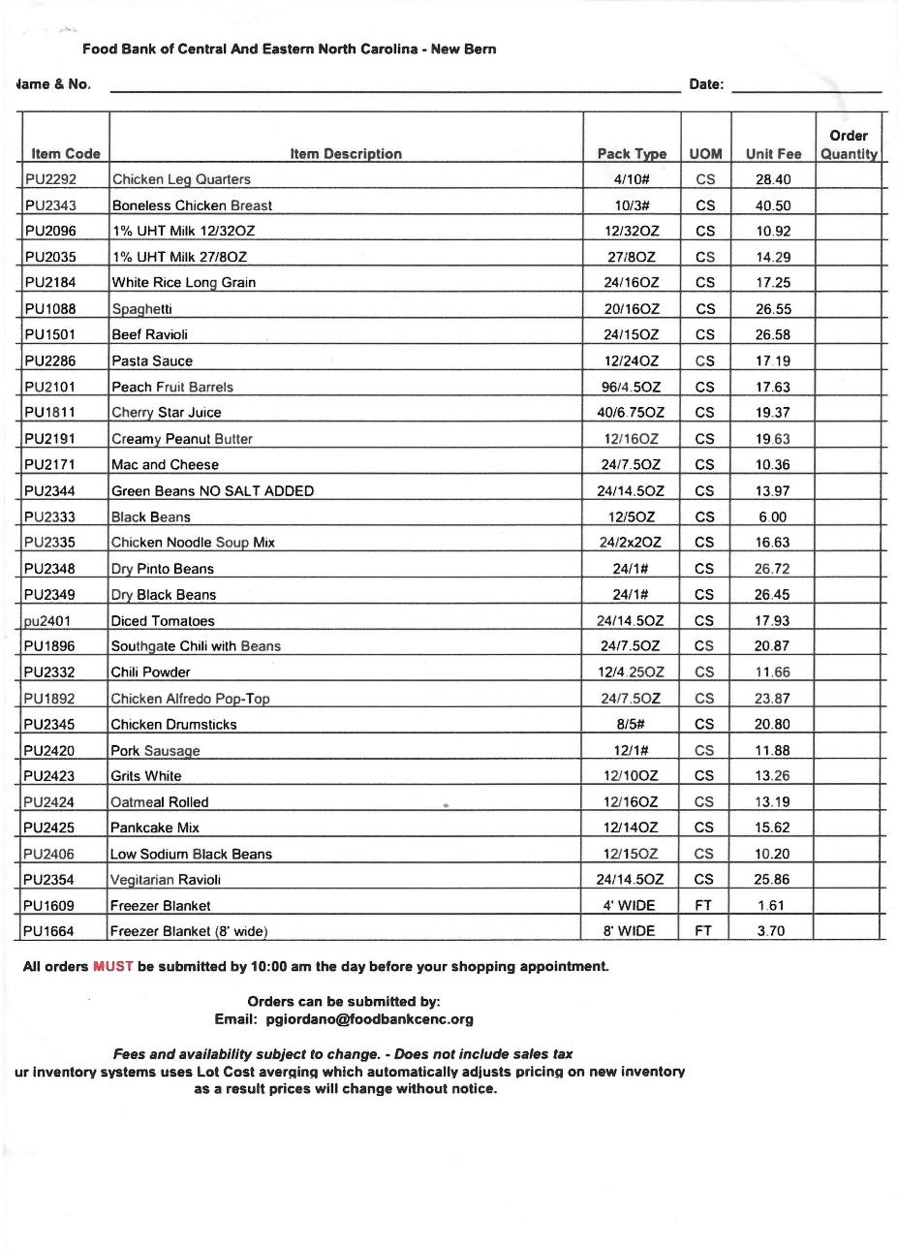
New Bern Food Bank Prices – In your packet

Slide 19
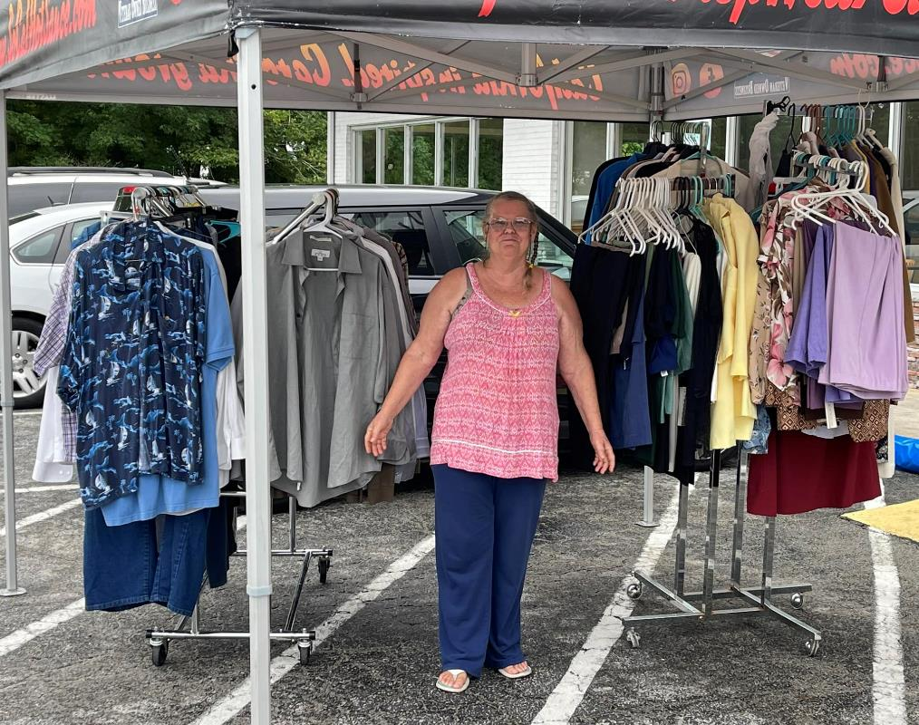
We offer free clothing to our guests.
This is Darline. She is a long time volunteer that runs our free clothing boutique. She makes sure that all the clothes donated are clean and in good shape.
We want our guest to feel valued as they shop from our clothing boutique.
We are not currently receiving any more adult clothing but are looking for children’s clothes for school and infants and will later be collecting coats for Winter.

Slide 20
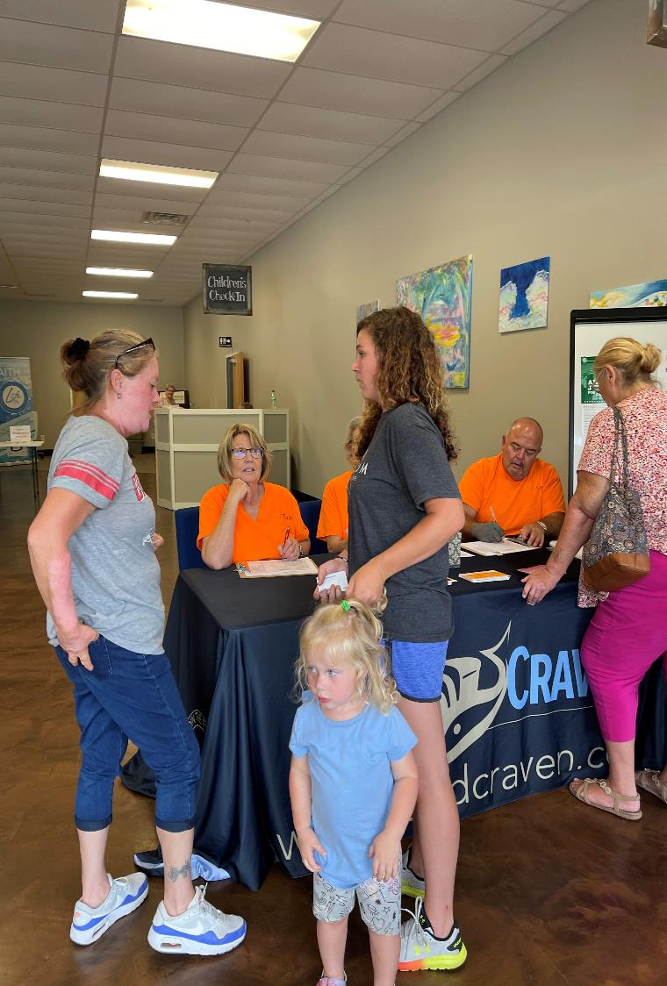
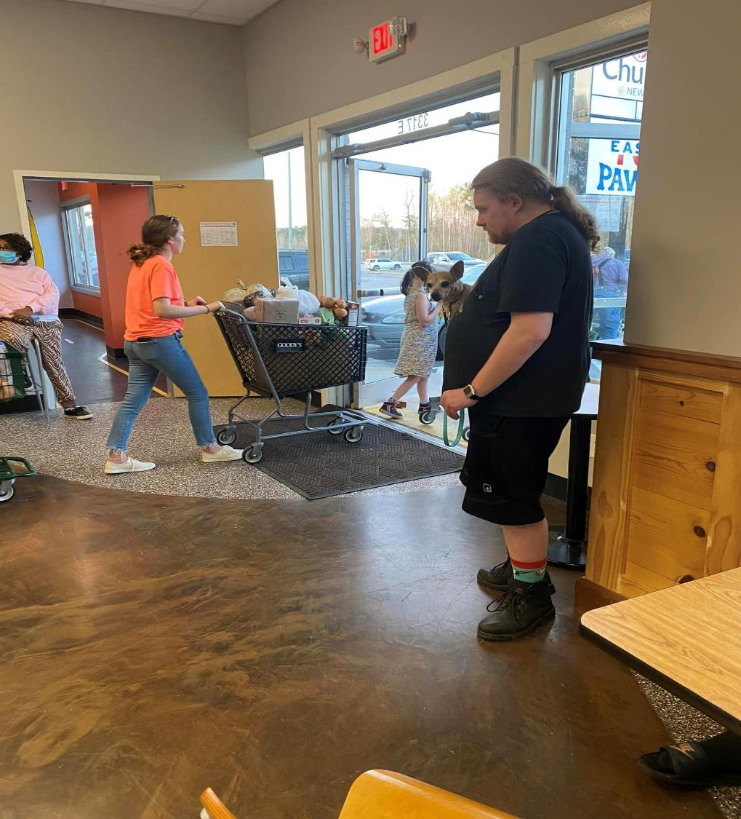

Slide 21
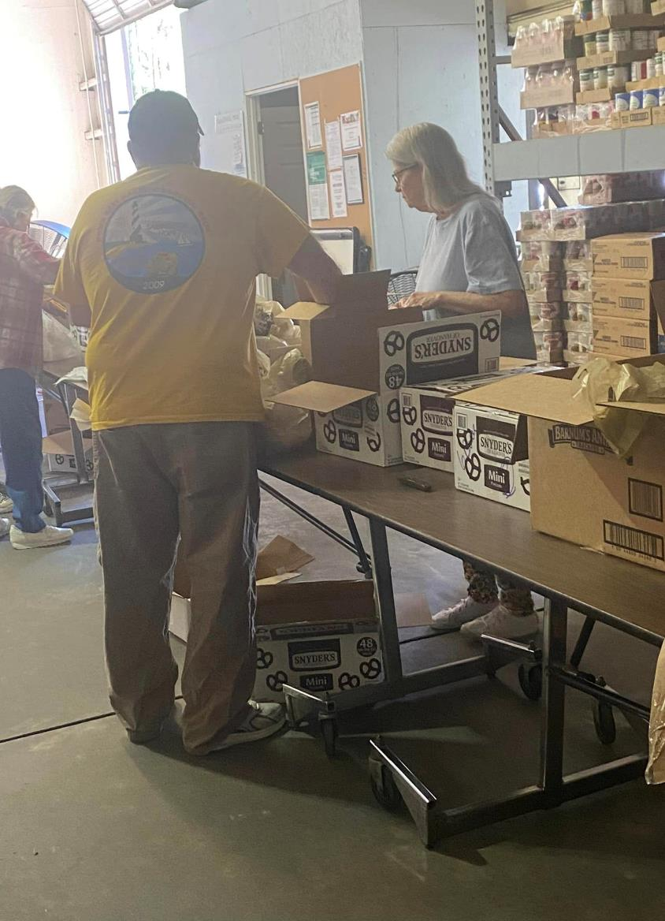
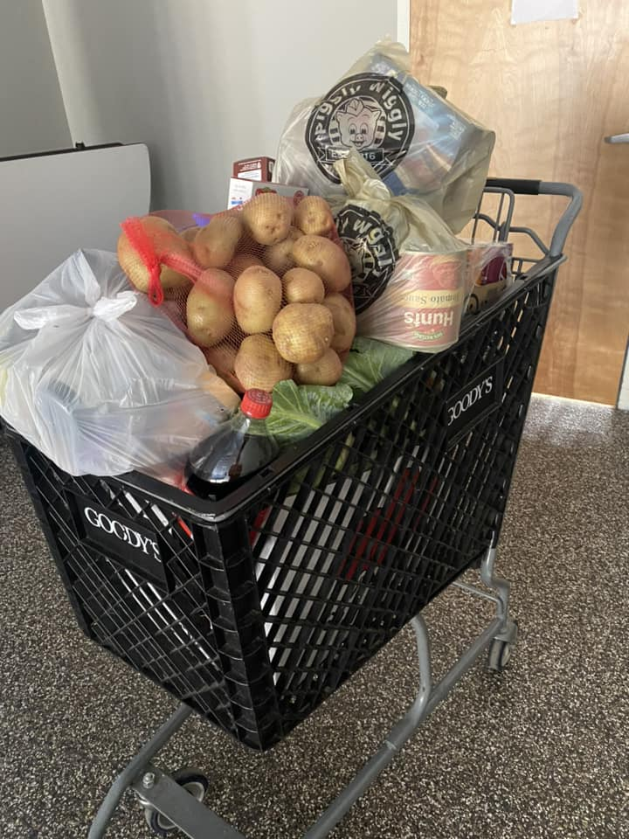
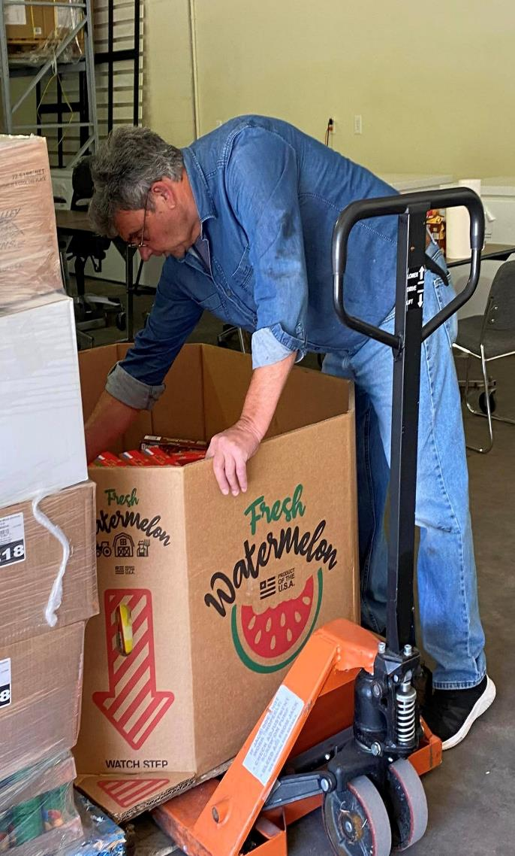

Slide 22
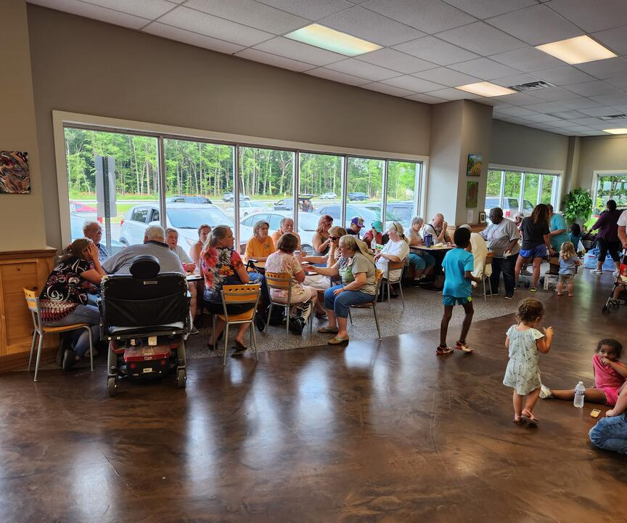
Guest Stories
We have a full house every time!
Sometimes guests come in with sad faces because they are afraid they aren’t going to make it through the month, and we LOVE seeing them leave with a happy smile!
Look at all those babies!
We love to get to know our guests too. They become family.

Slide 23
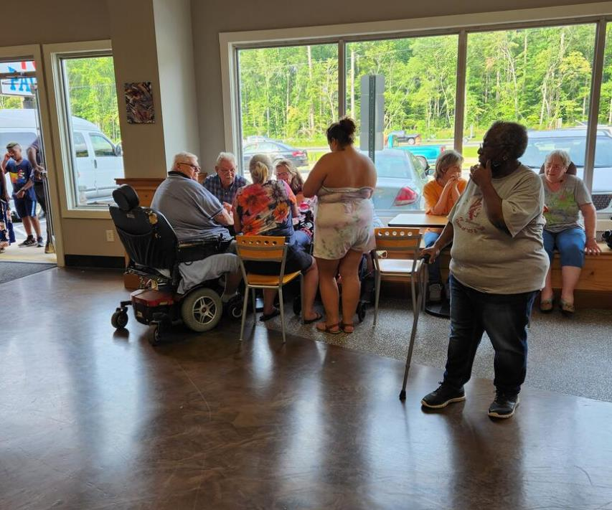
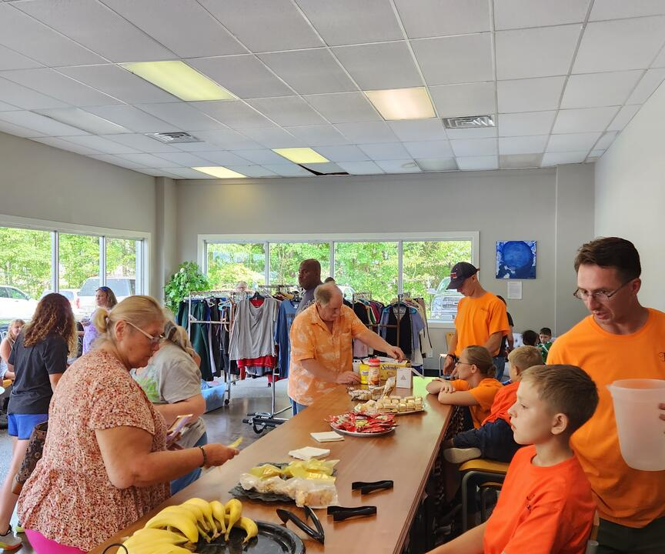
Guest Stories
We like to offer snacks and socialize with our guests while they wait for their baskets to be filled.

Slide 24
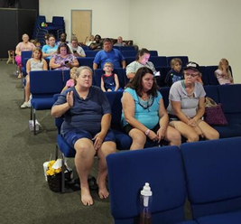
Guest Stories
We offer a church service for those who wish to attend.
We like to offer to not only fill their tummy’s, we like to feed their souls.
Many ask for prayer.
Many have experienced healing miracles.

Slide 25
Guest Stories
One man had been looking for a job and was able to find one. We gave him a referral for installers position that was hiring and he got the job! He is sharing the opportunity with his friends. We had been praying for him for sometime to find work and he was so grateful his prayers were answered. He said it was faith building for him.
One woman was sitting in the sanctuary and this was her 1st time back in church since her mother passed away many years ago. She said she was so blessed by the service and the food. She is the sole provider for a family of 4 and doesn’t make much money. She said she was definitely coming back and will tell her friends.
From a grandma:
“Tonight was amazing. My 9 yr old grandson took a step of faith and went up and got healed tonight. He got hurt a few days ago, he hurt his leg real bad, been hurting so much he couldn’t walk or move on it. After someone prayed for him, he was jumping up and down on it and he was good as new! Thank you for doing this service for our area.”

Slide 26
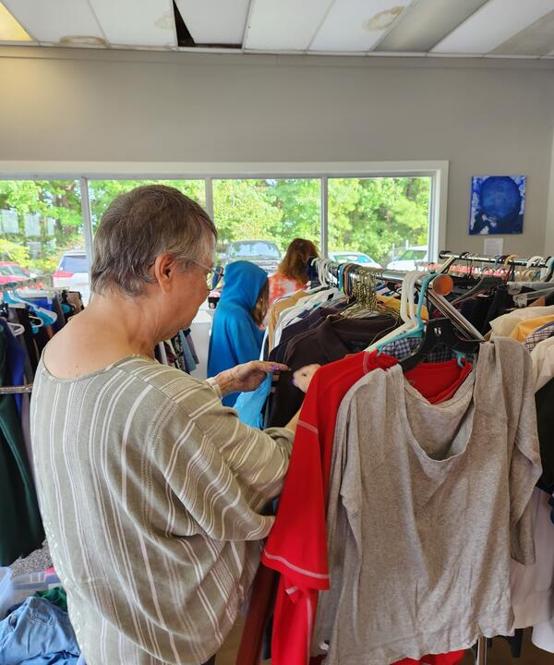
Guest Stories
A granddaughter was so grateful to be able to get both of her grandma’s some much needed new pants.
Our guests continue to thank us for making them feel welcome, loved and valued. We truly are a family and it shows.

Slide 27
What a typical distribution looks like…
A guest will arrive and register. They verbally state how much they receive monthly and if they are on food stamps.
We give them a ticket number and invite them to grab a snack, shop and socialize while waiting for their grocery food carts to be delivered.
During the wait, if they choose, they can visit the worship center to listen to music and/or hear a short uplifting and encouraging message.
The volunteers start filling the baskets full of food.
When the food is ready for distribution, we call out the numbers in which they were given.
We take the grocery carts to their cars and unload them for our guests. Another way to continue to make them feel special.

Slide 28

Our Budget To Maintain Operations
Groceries: $1,000 per month.
Operational: $500 per month.
  GFL Disposal, Fuel, Misc. Supplies
We depend solely on contributions and donations.

Slide 29
Where We Want to Be…
Blessings Truck Contract
HVAC Unit Needed
Power Backup/Electrical
Thanksgiving Dinner Boxes Giving Opportunity

Slide 30
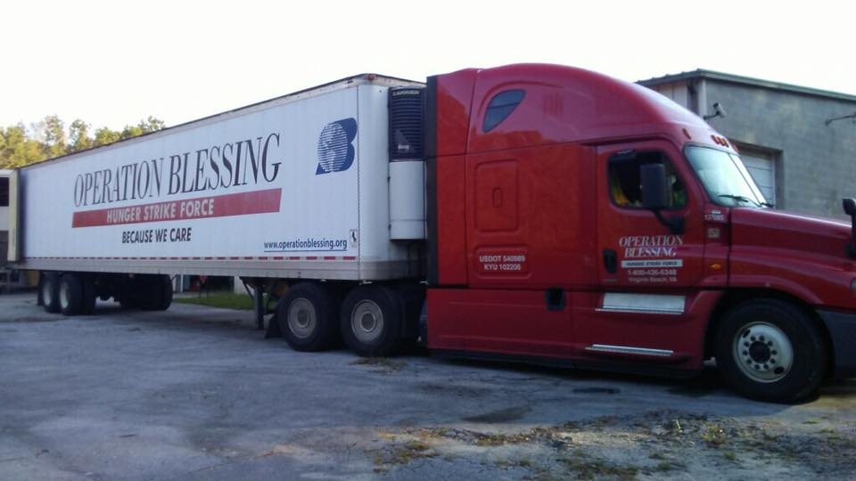
Blessings Truck Contract
We would love to not have to ask our guest about their income/food stamps status and allow them to have their dignity remain in place. Our goal is to be free of using TEFAP and be able to contract with Operation Blessings. This will allow us to purchase either a full or half truck of fresh, quality and commercial foods. It costs $2000 to $1000 a month, respectively.

Slide 31
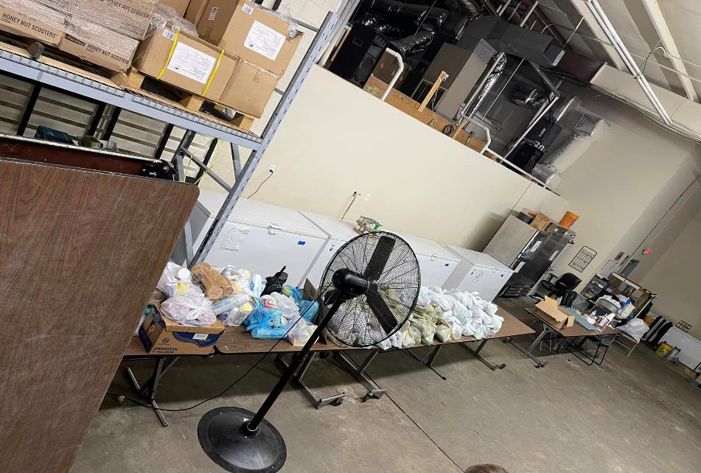
HVAC AND GENERATOR NEEDS
We desperately need an HVAC unit and a backup power generator. Currently we have zero heating/cooling in the warehouse and sometimes it gets in the triple digits in the summer and fall or cold in the winter. This is very hard on our volunteers’ health. We only have a few fans to circulate the air. Also, it is very important to save the very large amount of frozen and refrigerated food when power to the building is lost. All necessary costs to have a conditioned space with HVAC is $20,000. We currently have $10,000 saved but still need another $10,000. The automatic backup power generator with necessary electrical needs would run $15,000.

Slide 32
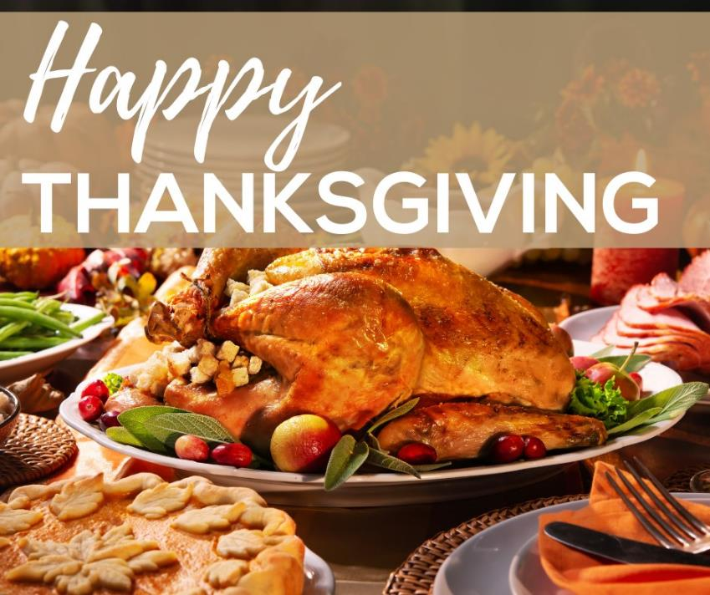
Thanksgiving Dinner Boxes
We like to give Thanksgiving Dinner boxes complete with a Turkey and all the fixings.
This is fully funded by Volunteers and Sponsors.
We are looking for organizations to come alongside us via gift cards from local grocery stores or to actually collect the foods for us to pack.

Slide 33
Where we are going…
We love our Sponsors and Donators so much! We really couldn’t do it without them.
We are looking for organizations, such as yourself, to come alongside us to help families. This can be through a Food Drive, a one-time gift, or a recurring gift donation.
Feed Craven Food Pantry is a 501(c)(3) organization as established by Title 26 USC 508. All monies are tax deductible in the year given. A tax deduction receipt will be provided. We are also happy to give your company or organization a huge shoutout on social media and on our website.

Slide 34
Food Drives
We are looking for organizations to partner with us outside of a store such as Walmart or a major grocery store.
We would provide a shopping list that you could hand out to the customers as they enter the store. We could provide a table and a Feed Craven tablecloth and would welcome you to provide any info about your organization as well.
We would be on hand to take pics and pick up foods unless you want to deliver them. The shopping list would include items such as bags of rice, beans, peanut butter. Something to stretch a meal.

Slide 35
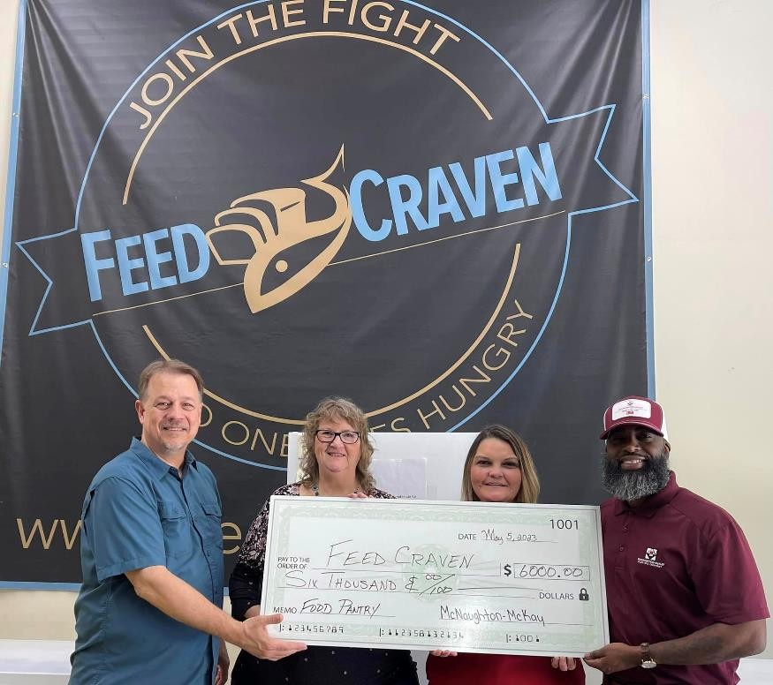
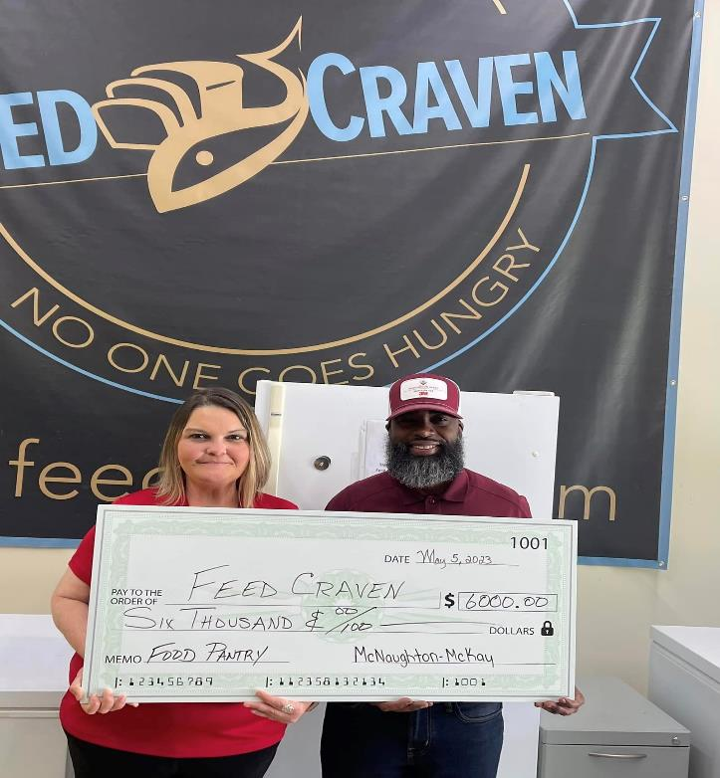

Here is a shoutout to our local Sponsors:
Thanks to McNaughton-McKay Electric for a
$6000.00 donation!

Slide 36
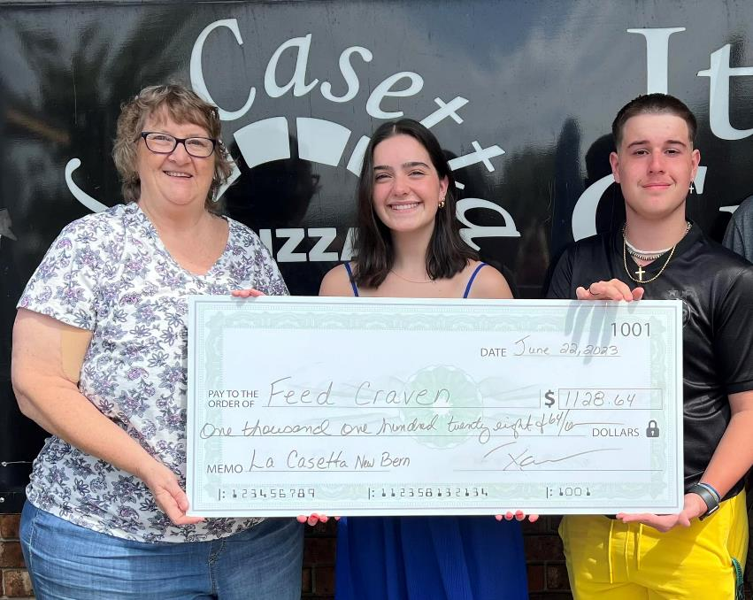
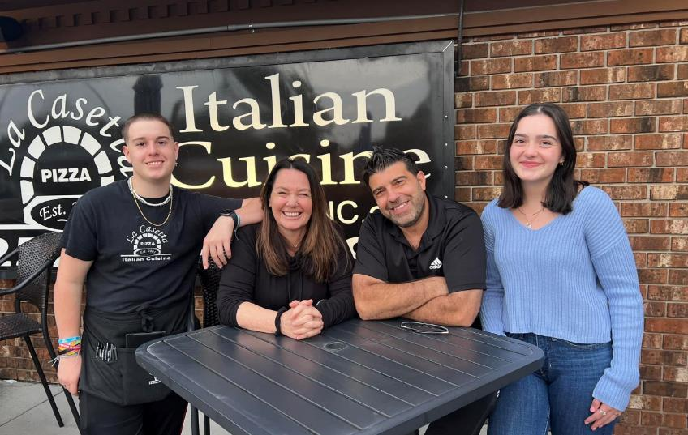
Thanks to La Casetta New Bern Restaurant for a $1128.64 donation!

Slide 37

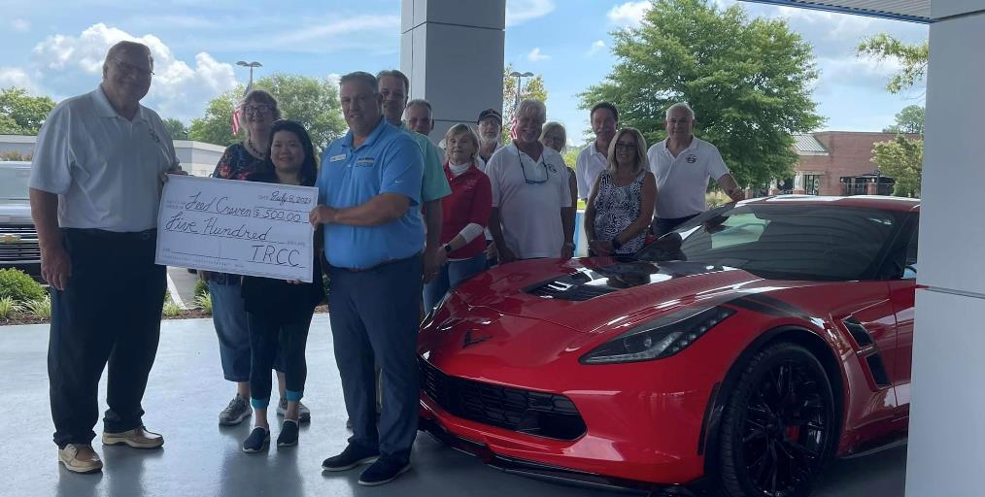
Thanks to the Twin Rivers Corvette Club,
New Bern for their $500.00 donation.

Slide 38
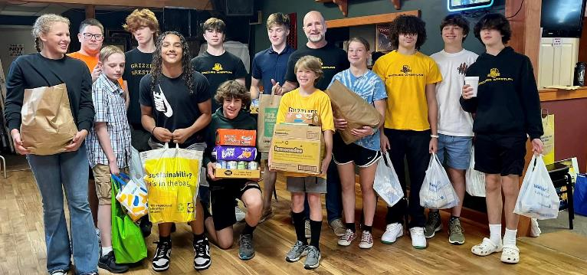
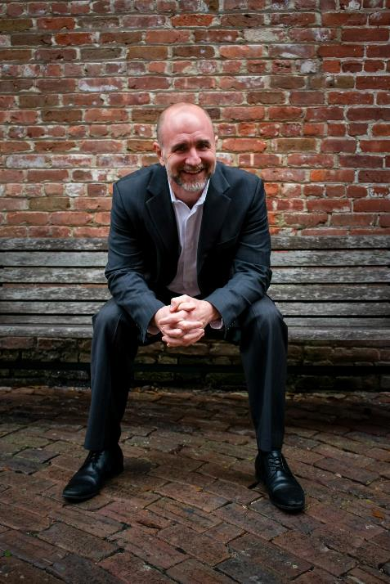
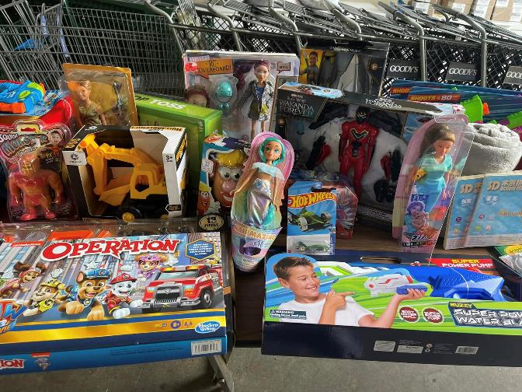
Thanks to Jamie Yezarski, Keller Williams Realtor and Wrestling Warehouse Owner for a continued Food and Toy Drive!

Slide 39
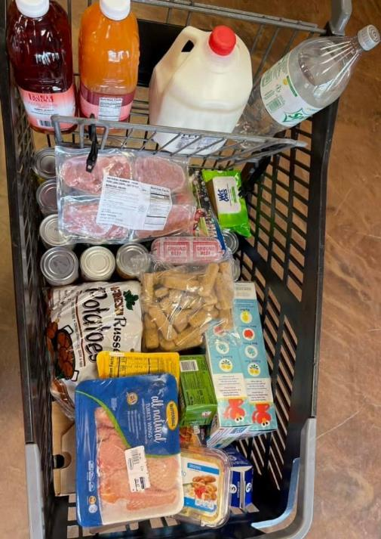
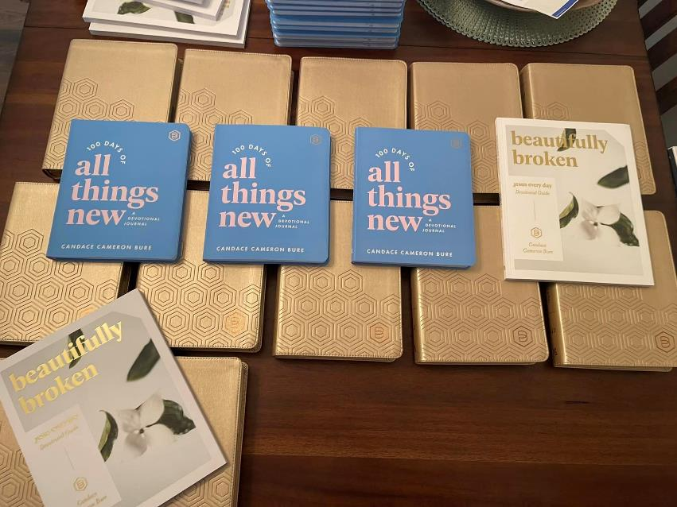
Thanks to an anonymous donator that gave funds to purchase bibles and devotionals and another to purchase foods.

Slide 40
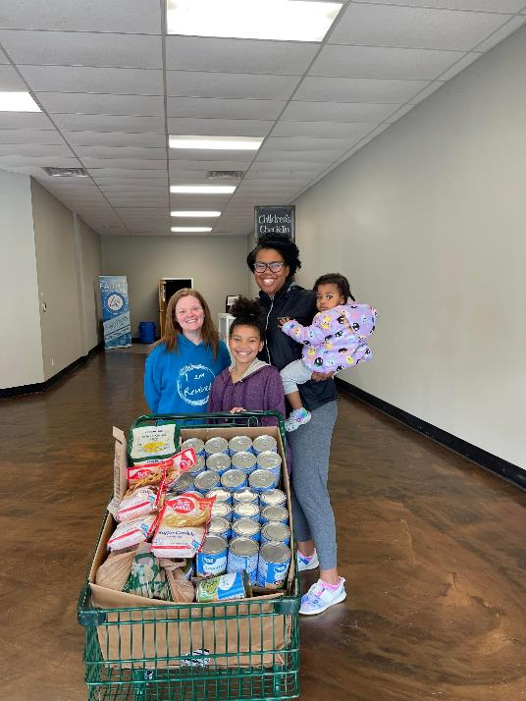
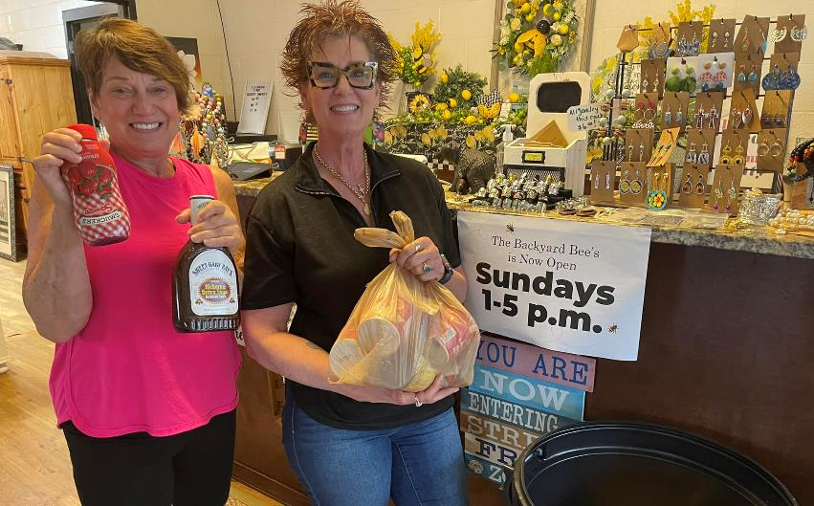
Thanks to The Backyard Bees and Bath & Bodyworks for doing a Food Drive in their stores.

Slide 41
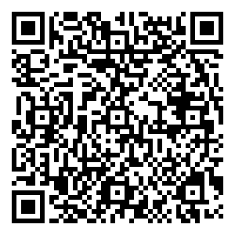
And finally, if you would like to help us, here is our QR Code and you will automatically be sent a tax deduction receipt!
Or let’s connect and discuss
how you can help us
“Feed Craven!”
www.feedcraven.org
Thank you for considering!

Slide 42
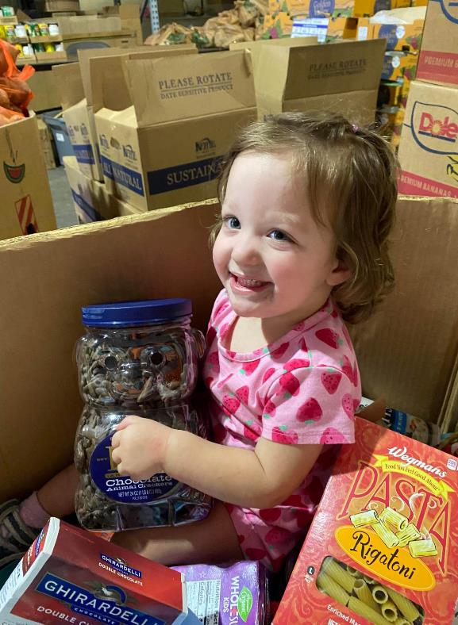
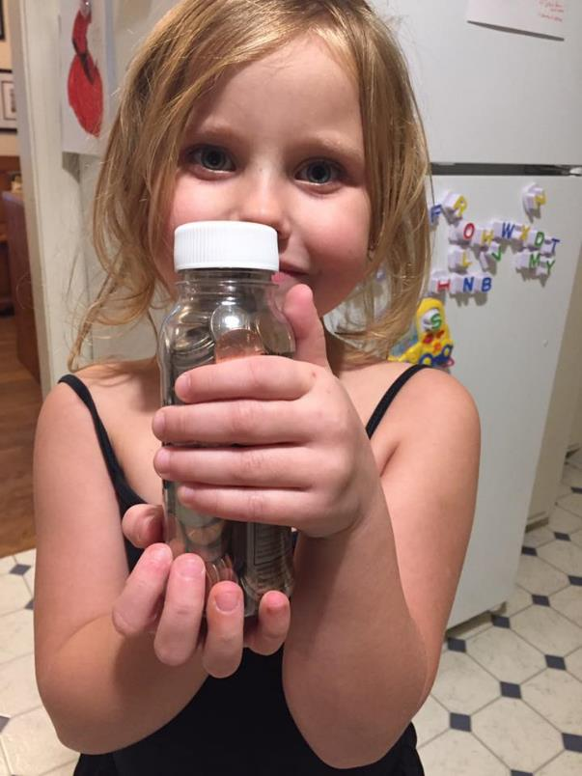

Thank you so much for helping us
“Feed Craven!”

